Slide 1
Student –Teacher Booking Appointment
Made by: Ayush Agrawal

Slide 2
Tech Stacks used:
HTML
CSS
Javascript
Bootstrap
Firebase

Slide 3
Includes:
Admin Page(Update & Delete)
Teacher Login Page(Schedule Appointment)
Register Page
Student Login(Book Appointment &Send Messages)
Realtime updating firebase (NoSQL) database .

Slide 4
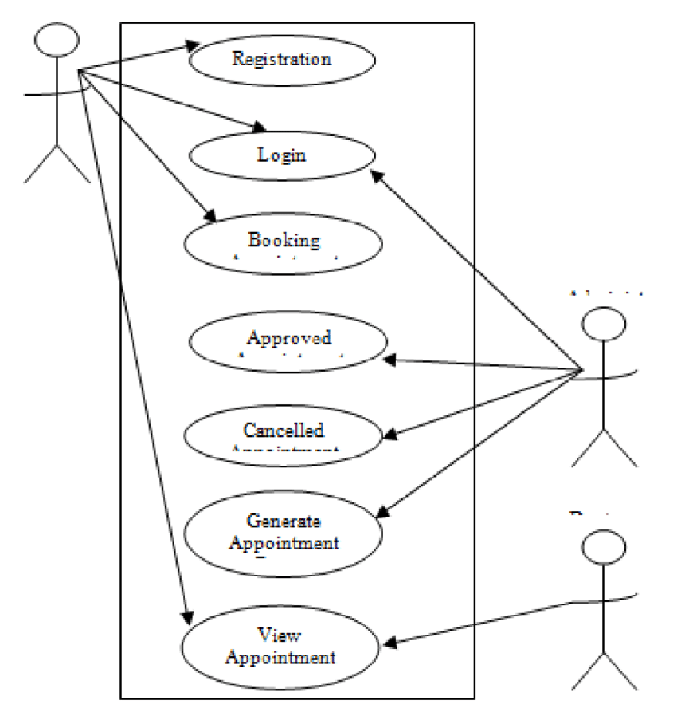
Architecture:
Teacher
Student
Admin

Slide 5
Appointment Booking
Visit the Institution's Website : Go to your school or university’s official website. Look for a section related to student services, academic support, or a similar department.
Access the Booking System: There may be a dedicated portal for booking appointments with teachers or advisors. This could be called a student portal, learning management system (LMS), or a specific booking platform.
Log In : Use your student credentials (username and password) to log in to the system. This ensures that only current students can book appointments
Select an Available Time Slot : Browse the available time slots that the teacher has opened for appointments. These are usually displayed in a calendar format.
Book the Appointment: Click on your preferred time slot and follow the prompts to confirm the appointment. You might need to provide a reason for the appointment and any additional information that can help the teacher prepare.

Slide 6
Login and Register Page
The user whether a teacher or a student can first register using a username and password of their choice and their information will be stored in a real-time database.
Now, when they will try to log in the username and password will be fetched from the database and will lead to a successful login.
Used CryptoJs in the database so, the password will be encrypted according to a key and will not be easily decoded even if it falls in the wrong hands.

Slide 7
Real Time Updating Table
Successfully implemented all CRUD Operations.
One teacher or student can update, insert, select, delete, or change any of their pre-stored information. The changes are successfully stored in the firebase real-time database.
A Teacher can add or delete a student’s appointment records as soon as an appointment is over or a new appointment is scheduled just by button clicks.

